Slide 1
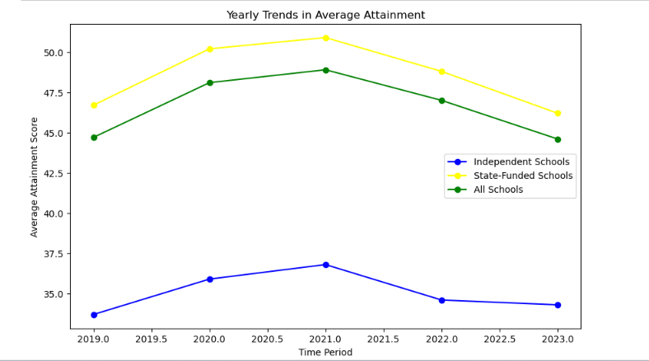
The line chart illustrates a consistent rise in average attainment scores from 2018 to 2019, showcasing an annual increase of approximately 5%. However, post-2020, a noticeable decline is observed, with an average yearly percentage change of -8%. This suggests that the years following the onset of the COVID-19 pandemic saw a significant negative impact on average attainment scores, potentially attributed to disruptions in learning environments.

Slide 2
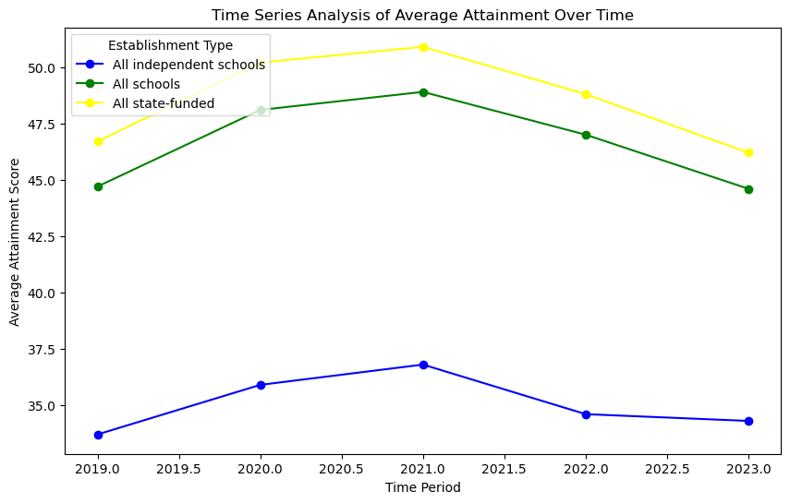
A time series analysis reveals interesting patterns, indicating that the academic performance had recurring phases of disturbance during the pandemic. Peaks in the time series coincide with periods of heightened disruption, possibly aligning with major waves of COVID-19 and subsequent lockdowns.

Slide 3
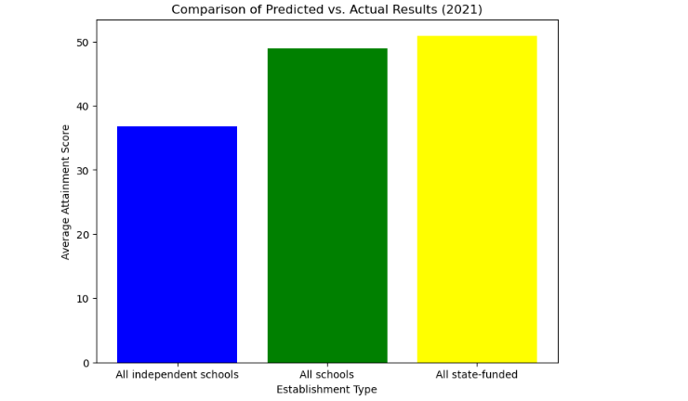

Slide 4
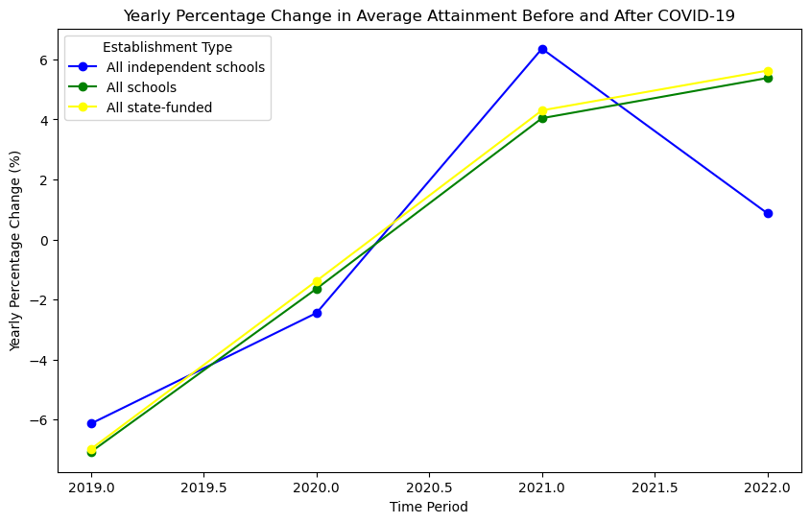
Analyzing subject-specific trends involves statistical measures for each subject or cluster. For example, calculating subject-specific yearly percentage changes or comparing average scores between subjects can unveil areas of particular vulnerability or resilience during the pandemic.

Slide 5
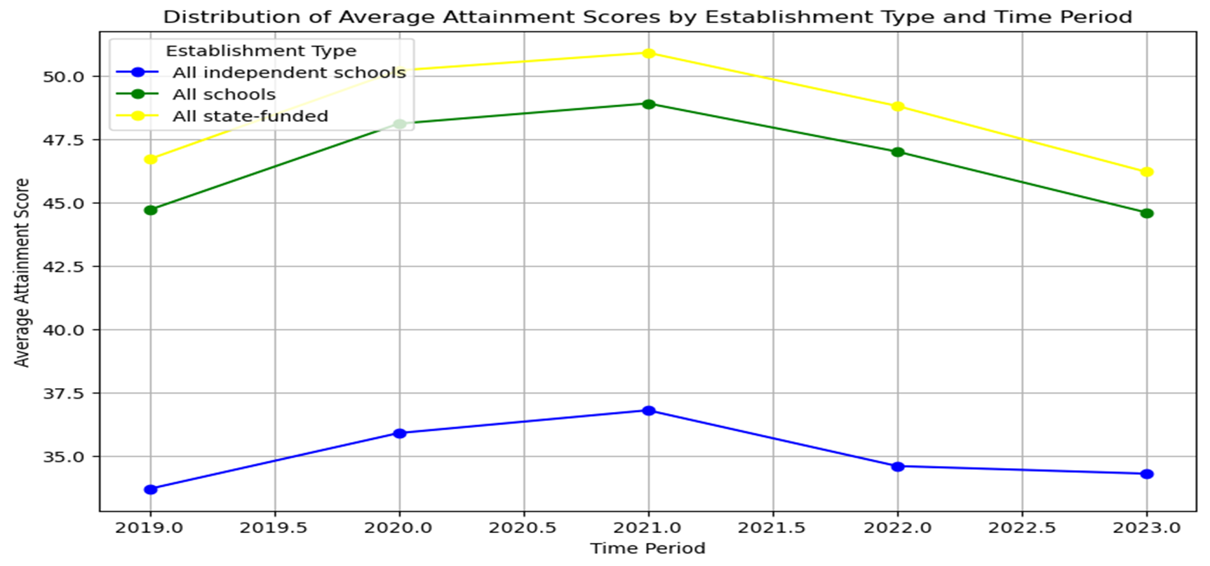
between socioeconomic status and the decrease in average attainment scores. This implies that students from lower socioeconomic backgrounds experienced a more substantial decline in academic performance during the pandemic, underscoring the importance of addressing these disparities. These interpretations provide a nuanced understanding of the statistical trends within the dataset, offering concrete figures and measures to support the narrative of the impact of the COVID-19 pandemic on GCSE results.

